Slide 1
Methodology Issues
Searching Based on Facial Information
Database Construction
Image Search
images
Has depth file?
Query Image
Face Detection
Has mask file?
Make Features (LBP)
Create Dummy Mask
Load Features
Compare Distance
Has feature file?
For all faces in DB and query images
Dist < minDist?
Make Features (LBP)
DB Images
Update Matching Face
Database
Calculate Matching Score per DB image
Category 1
Category 2
…
Category n
Ranking DB Images
by Score

Slide 2
Methodology Issues
Searching Based on Facial Information
Haar Feature-Based Cascade Classifiers [1]
De-saturate image to reduce the amount of data processed
Equalize histogram to compensate for lighting variations
Use Face Detection method developed by Lienhart et al [1]
Face Detection
Local Binary Patterns Histograms [2]
Create LBP image for each face region (radius=2, neighbor=8)
Calculate weighted spatial histograms of the LBP image (grid = 7x7)
Compare histograms of the two face regions (Chi-Square)
Face Recognition
Cross Checked Matching Score
score =qScore/# of faces (query) + dScore/# of faces (DB)
Max score = [-inf, 2.0], e.g. qScore= SUM(-1.0 x minDist[i] / FACE_THRESHOLD + 1.0)
minDist[i] : min( distance(face[i] in query, face[j] in DB) ) for all j
Ranking Images
Why Haar? Computationally heavier than LBP based detection, but provides more reliable accuracy.
Why LBP? Non-parametric method requiring no training data in contrast to supervised methods (e.g. PCA, LDA)
[1] Face and Facial Feature Detection Evaluation. M. Castrillón, O. Déniz, L. Antón-Canalís, J. Lorenzo. VISAPP 2008, Funchal, Portugal.
[2] Huang, Di, et al. "Local binary patterns and its application to facial image analysis: a survey." Systems, Man, and Cybernetics, Part C: Applications and Reviews, IEEE Transactions on 41.6 (2011): 765-781.

Slide 3
Methodology Issues
Face Detection
Total Data
- 150 facial images (one person in each image)
Face Detection Only (Current)
1) Classifier
- haarcascade_frontalface_alt2.xml [1]*
- Tree-based 20x20 gentle Adaboost frontal face detector.
- Created by Rainer Lienhart.
2) Parameters**
3) Result
Face Detection + Facial Features
1) Classifier
- haarcascade_frontalface_alt2.xml [1]
- haarcascade_mcs_eyepair_small.xml [2]
- Classify faces only when one eye pair exists within the face.
2) Parameters for Eyepair Detection
3) Result
scaleFactor | 1.3
minNeighbor | 4
flags | CV_HAAR_DO_CANNY_PRUNING
minsize | cvSize(20, 20)
maxSize | cvSize(0,0)
scaleFactor | 1.1
minNeighbor | 4
flags | CV_HAAR_DO_CANNY_PRUNING
minsize | cvSize(20, 5)
maxSize | cvSize(0,0)
True Positive | 150 faces (100%)
False Positive | 5 non-faces
Accuracy | 150/(150+5) = 97%
True Positive | 115 faces (77%)
False Positive | 0 non-faces
Accuracy | 115/(115) = 100%
: We need an algorithm which provides higher true positive rates (detect all faces, while allowing for false-positive).
*xml files for trained classifiers: http://alereimondo.no-ip.org/OpenCV/34
**Tuning Parameters : http://fewtutorials.bravesites.com/entries/emgu-cv-c/level-3c---how-to-improve-face-detection
[1] Rainer Lienhart and Jochen Maydt. An Extended Set of Haar-like Features for Rapid Object Detection. IEEE ICIP 2002
[2] ENCARA2: Real-time detection of multiple faces at different resolutions in video streams, JVCIR, 2007

Slide 4
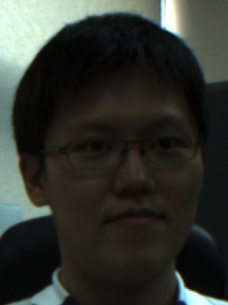
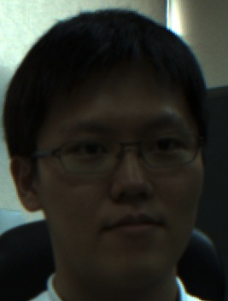



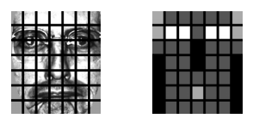





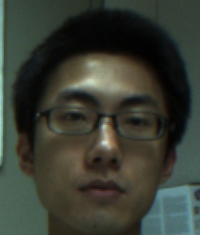
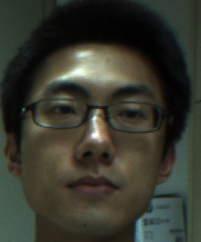
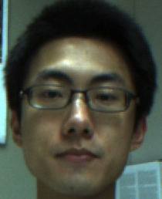
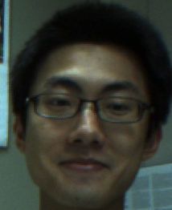
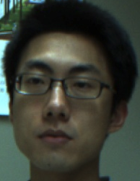
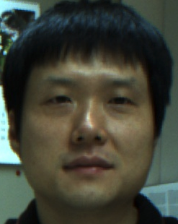
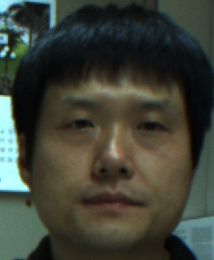
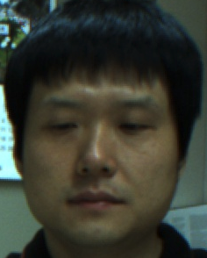
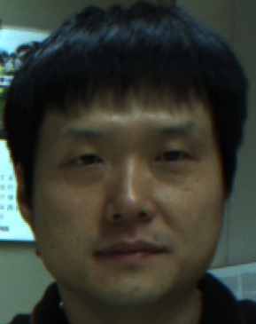
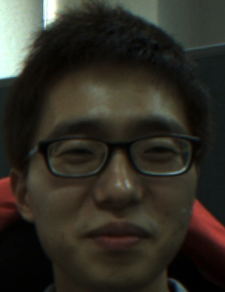
Methodology Issues
Face Recognition & Ranking Images
Total Data
- 130 facial images (one person in each image)
- 13 individuals with 10 images for each person
Local Binary Patterns Histograms
1) Parameters & Weights
2) Results
Test 1 : Ranking up to 10 images
Accuracy = # of recognized photos / 10 = 68%
Test 2 : Ranking up to 20 images
Accuracy = # of recognized photos x 2 / 20 = 88%
Avg. Execution Time (Searching 150 images) = 1.655222 sec
1.3GHz i5, 8GB 1600MHz DDR3, Intel HD Graphics 5000 1GB
- Examples (Good and Bad)
grid_x, grid_y | 8,8
radius | 1
neighbors | 8
FACE_THRESHOLD* | 100
* Chi-square distance threshold for comparing face histograms.
Test1 : 90%
Test2: 100%
Black | 0.0
Dark grey | 1.0
light grey | 2.0
white * | 4.0
Test1 : 50%
Test2: 60%

Slide 5
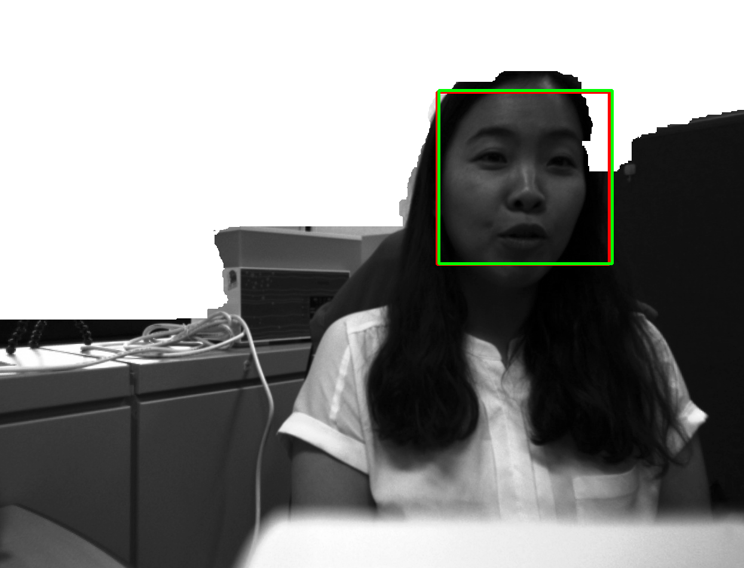
Milestone
Next Steps
TODO
Create Mobile App Prototype with JNI Interface
Exploit depth information such foreground + background
Test on public database and optimize parameters

Slide 6
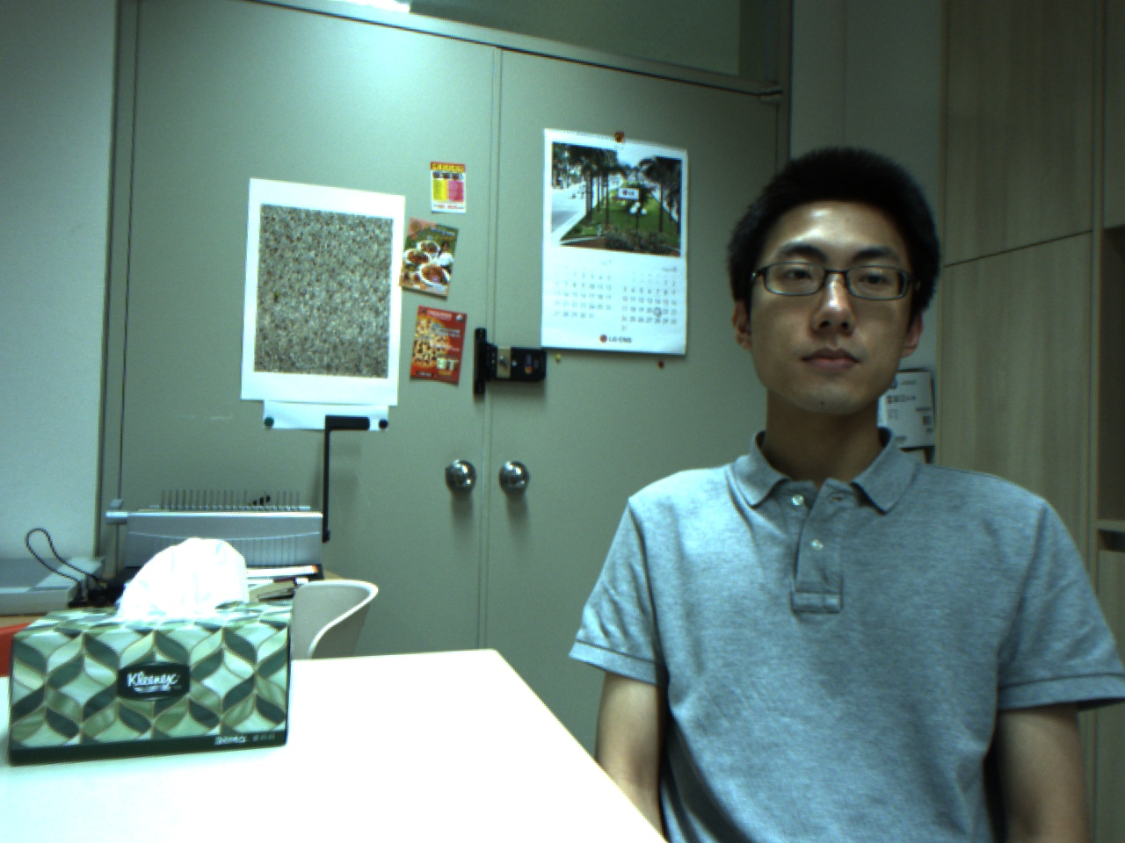
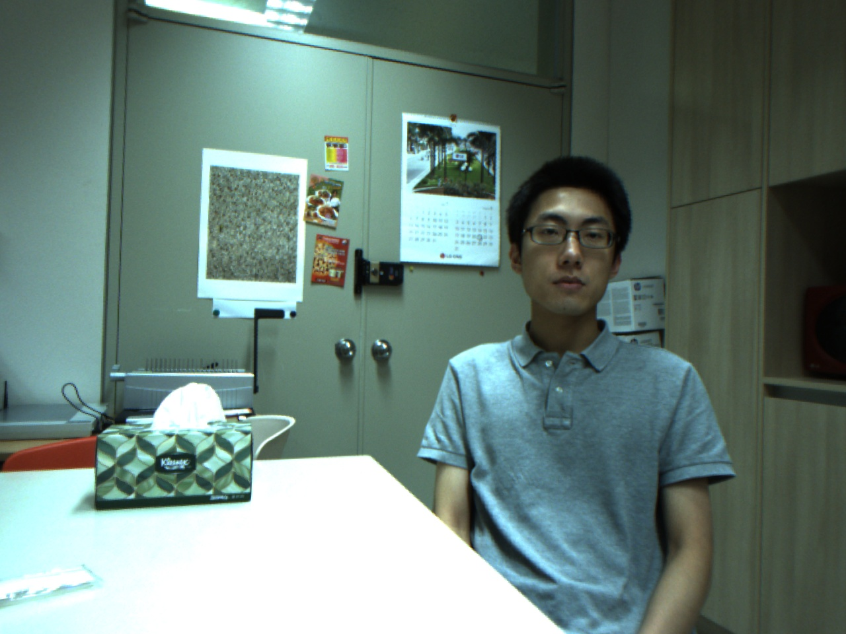
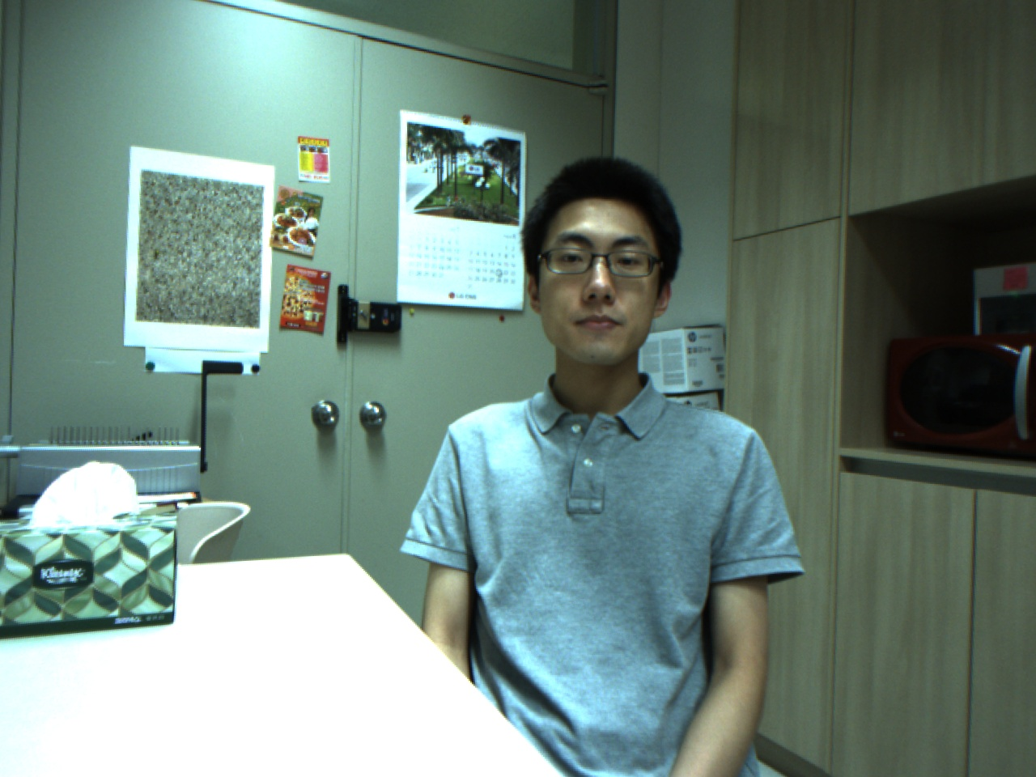
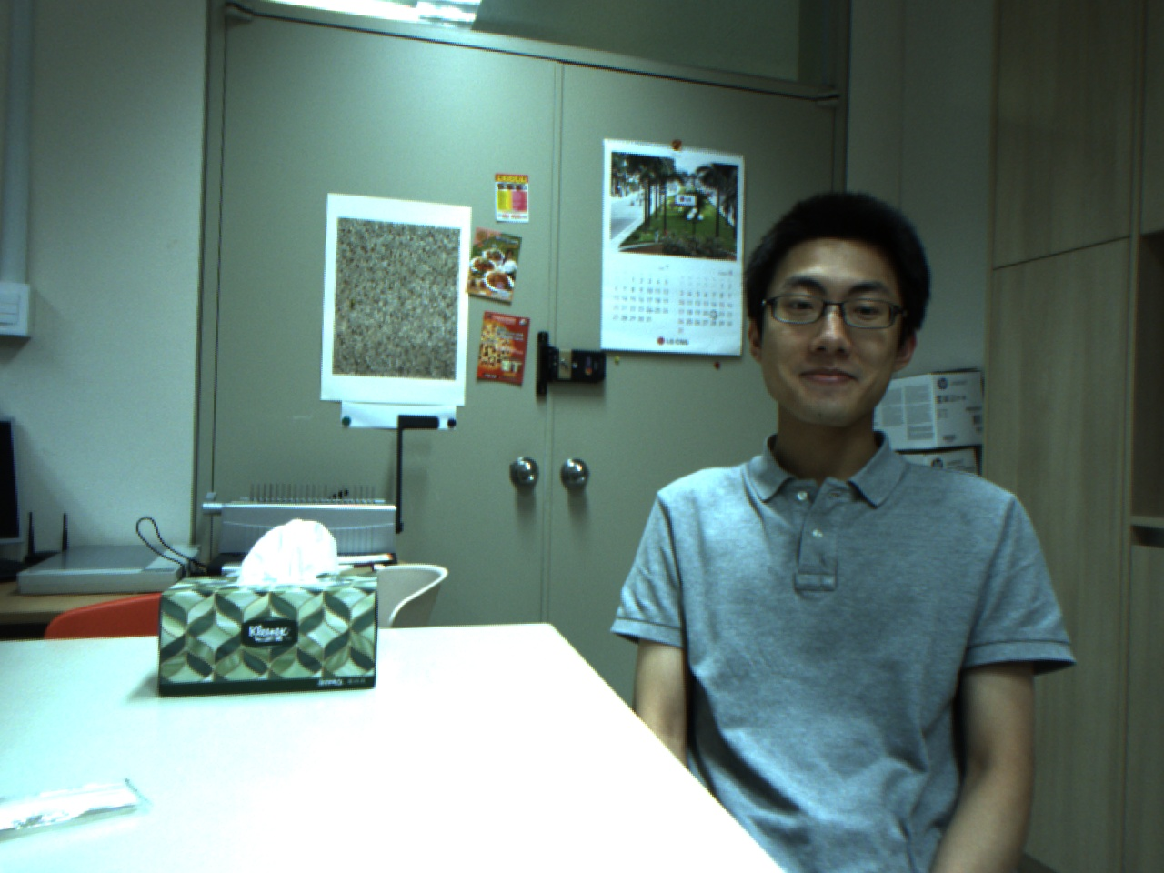
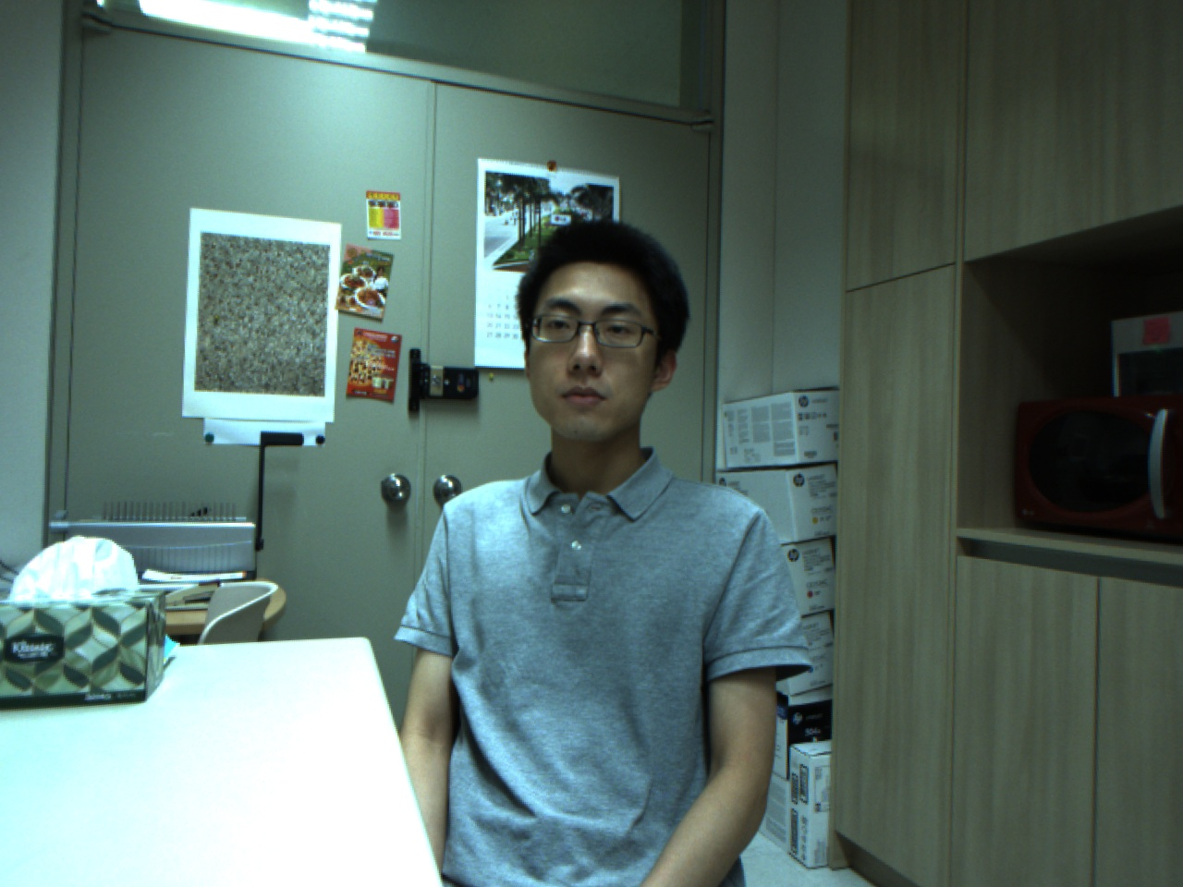
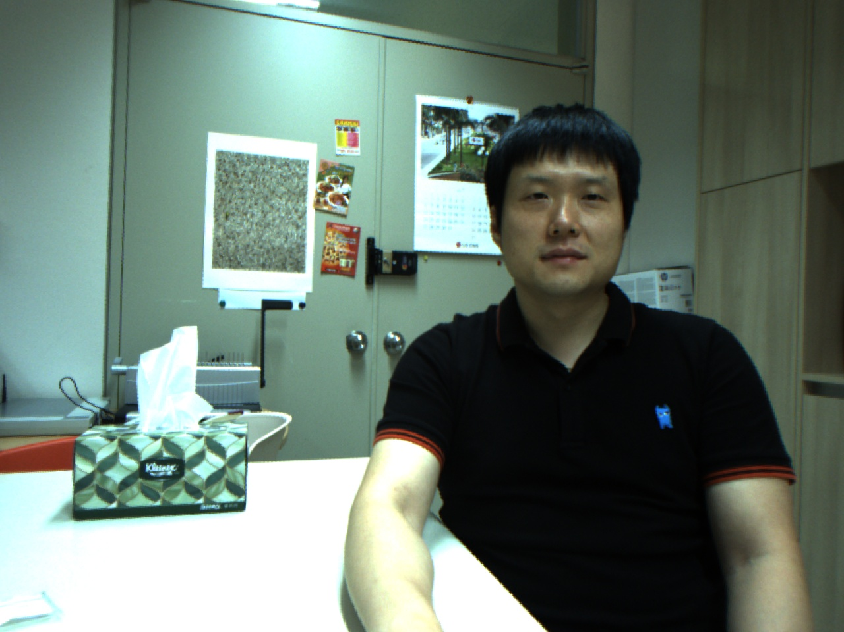
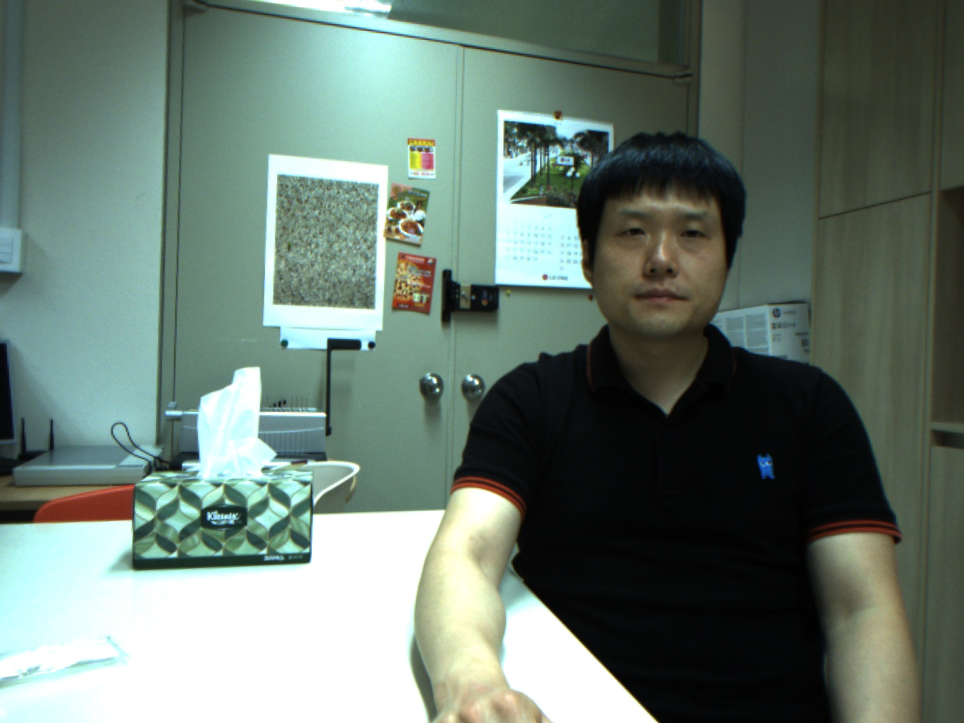
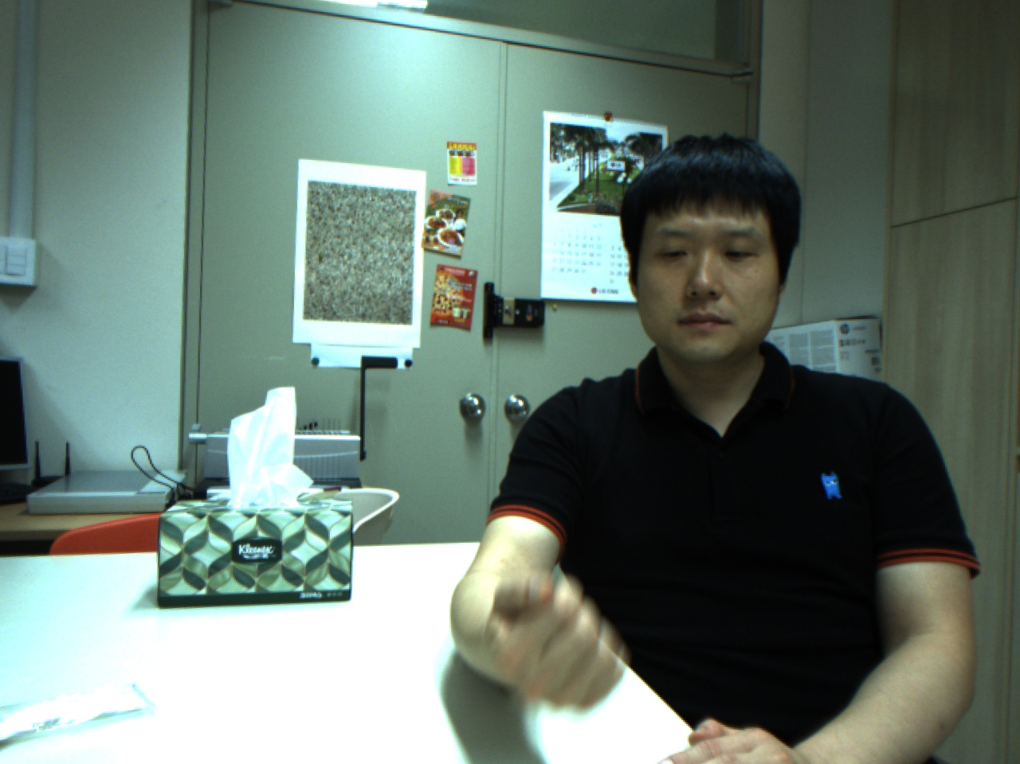
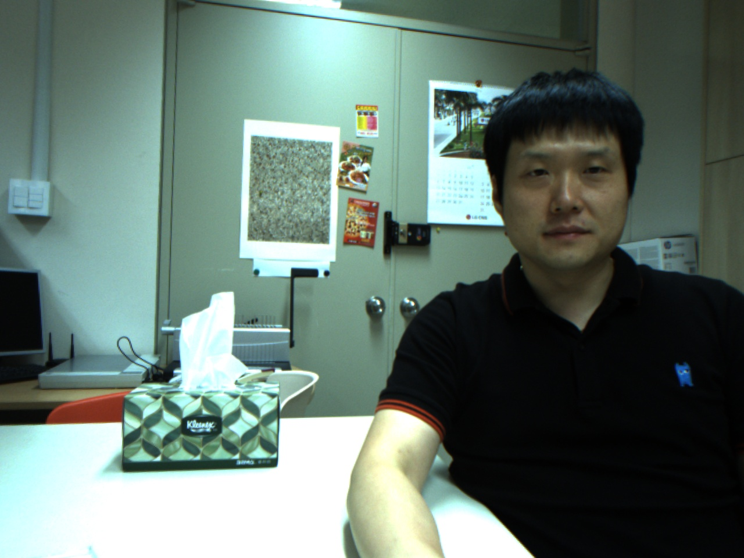
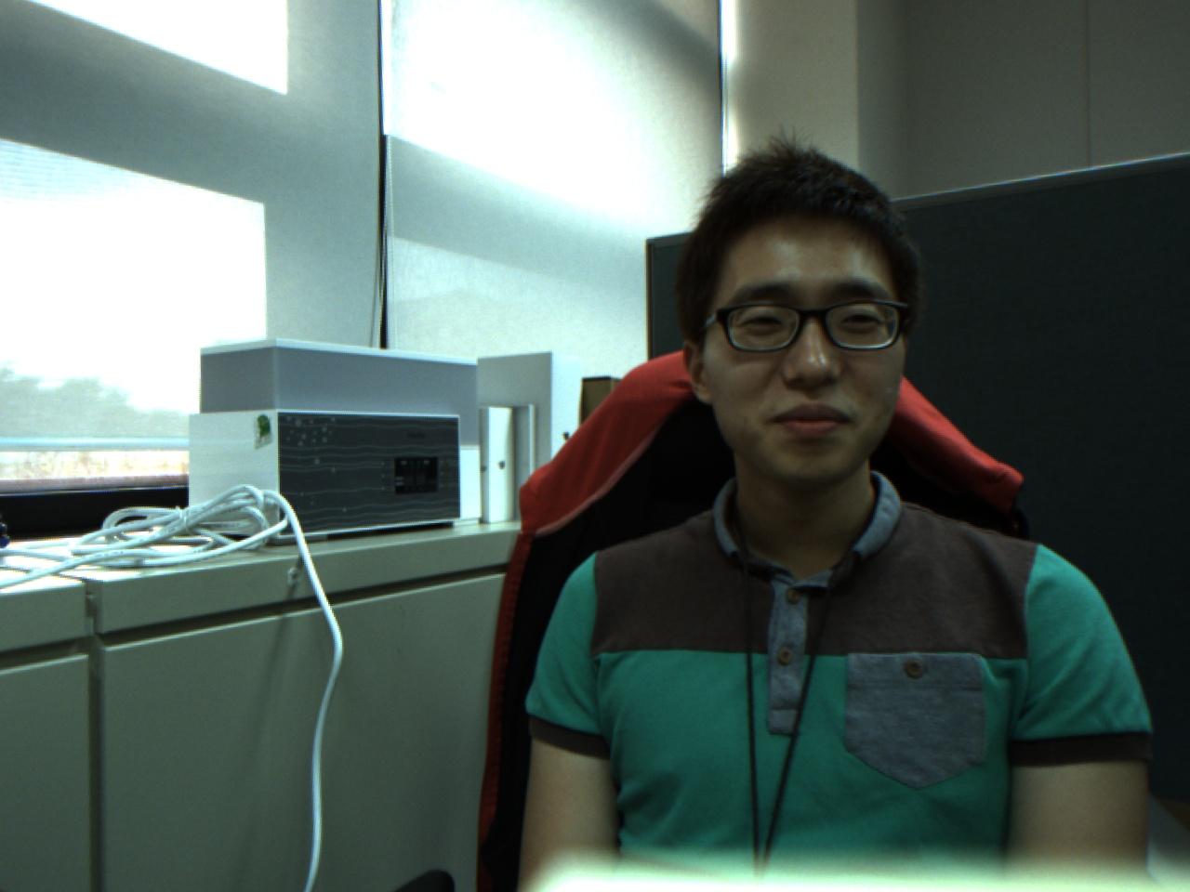
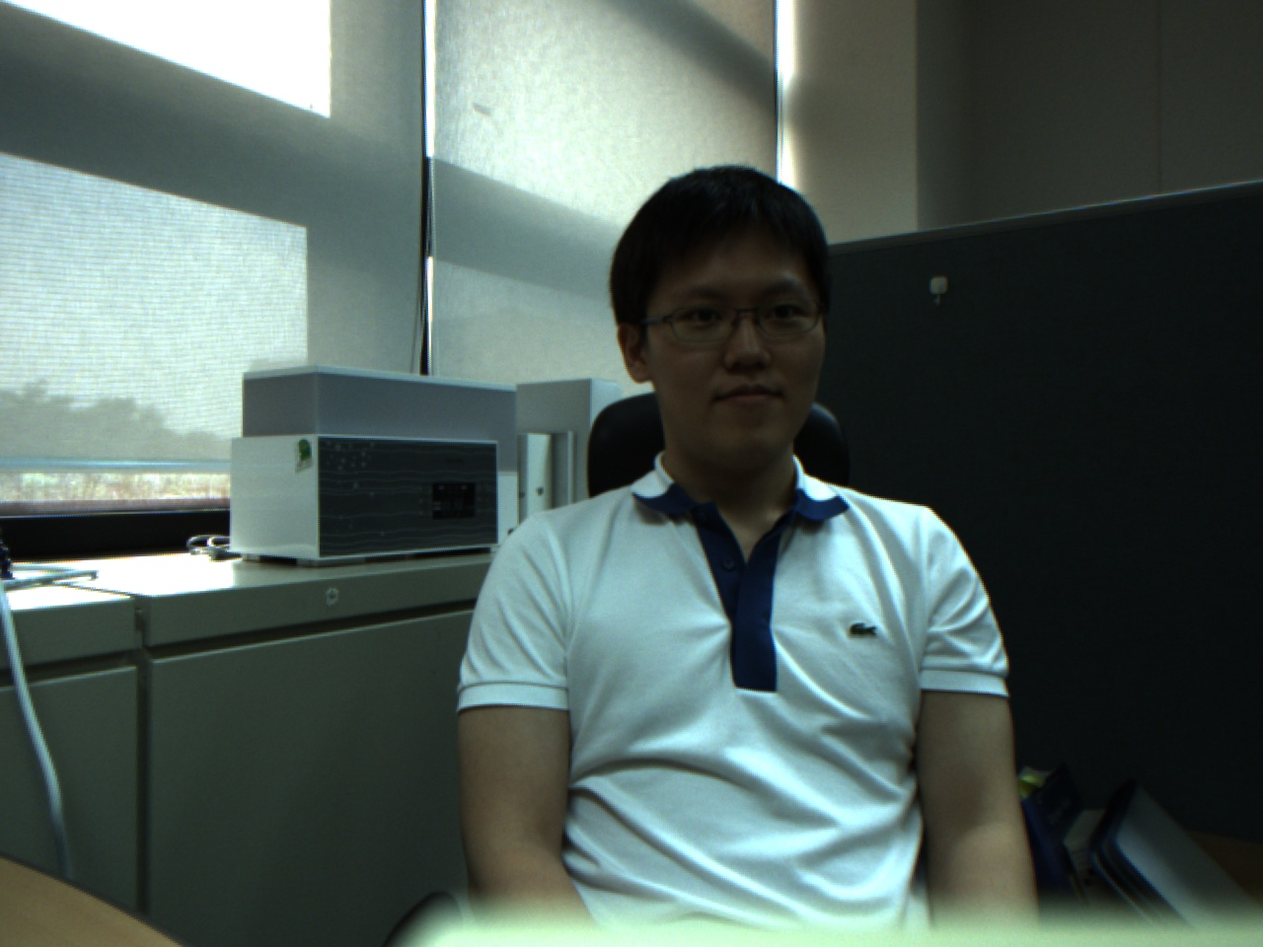
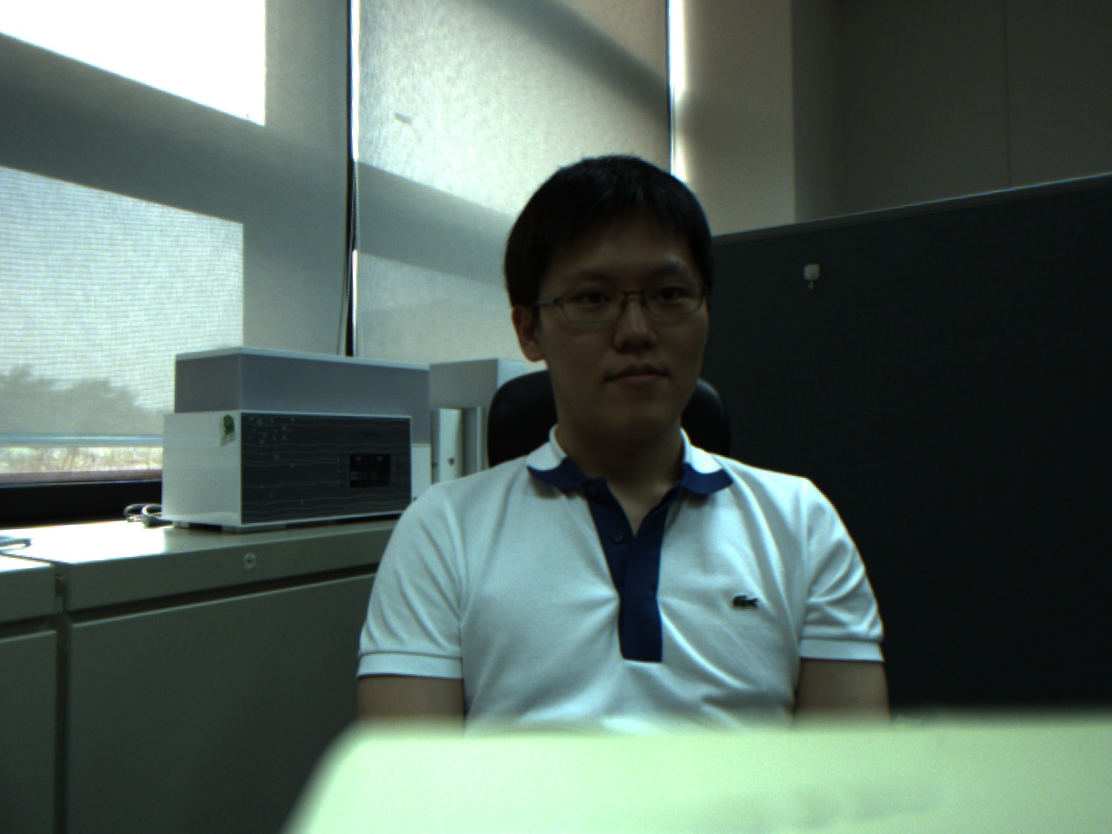
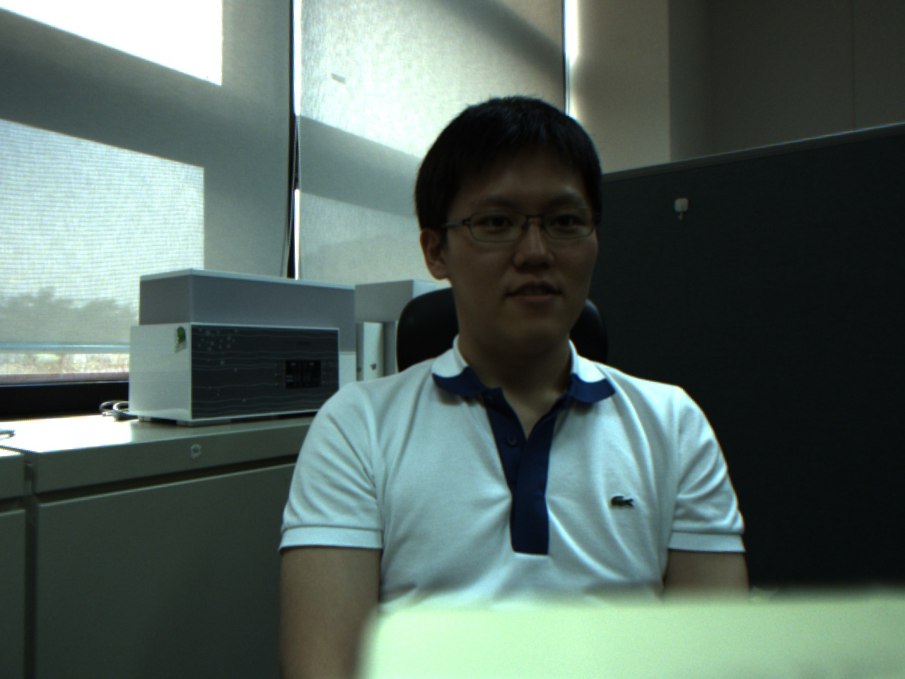
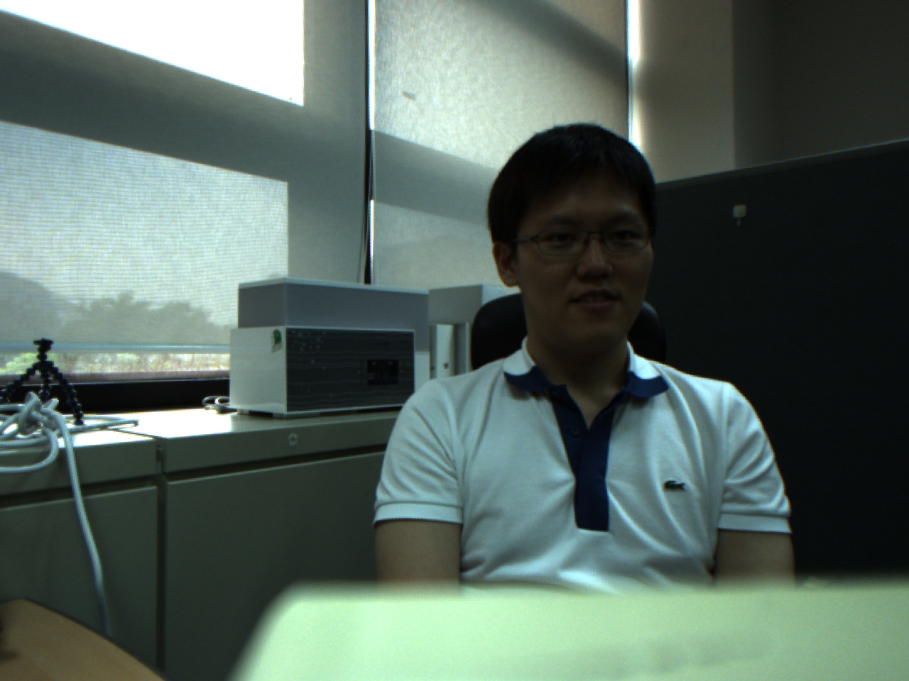
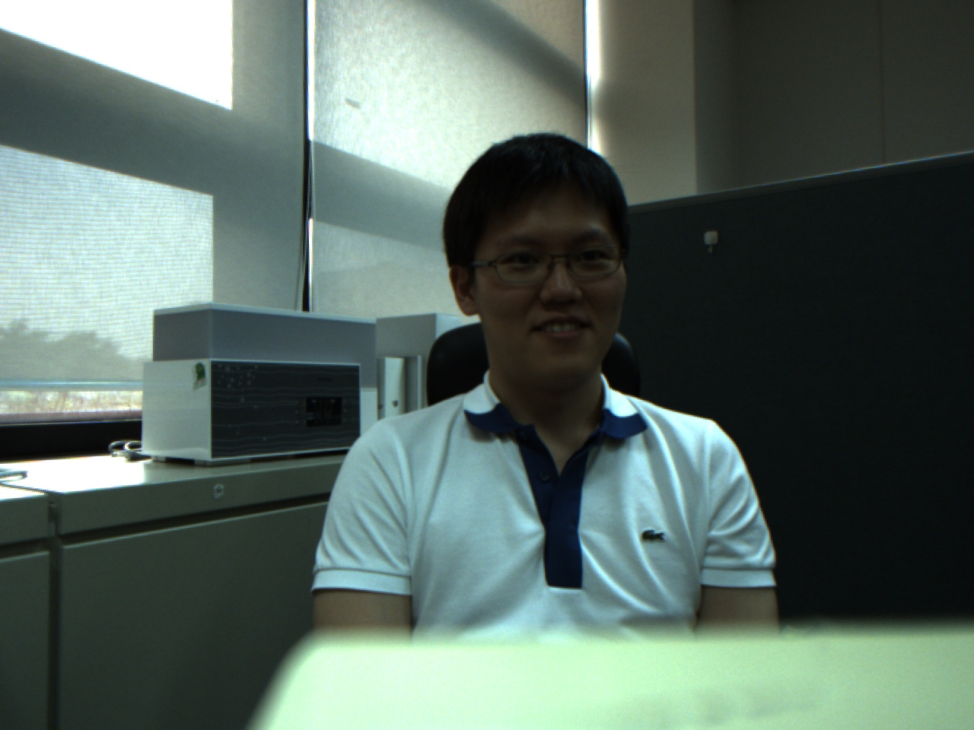
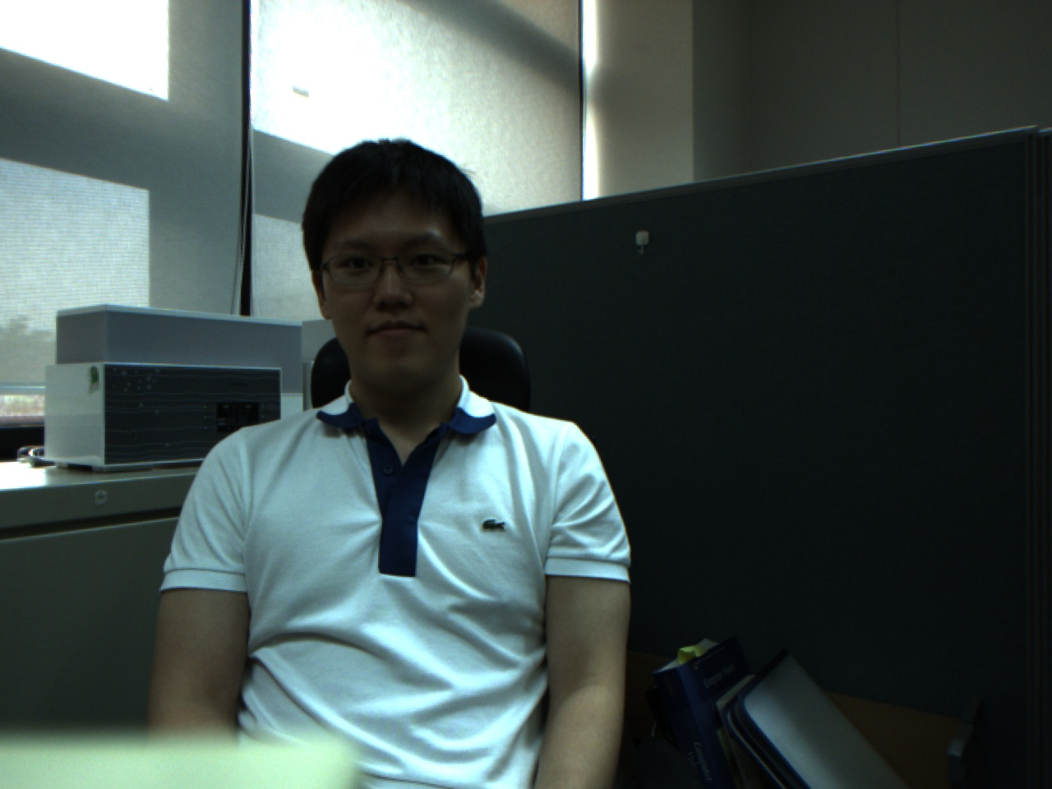
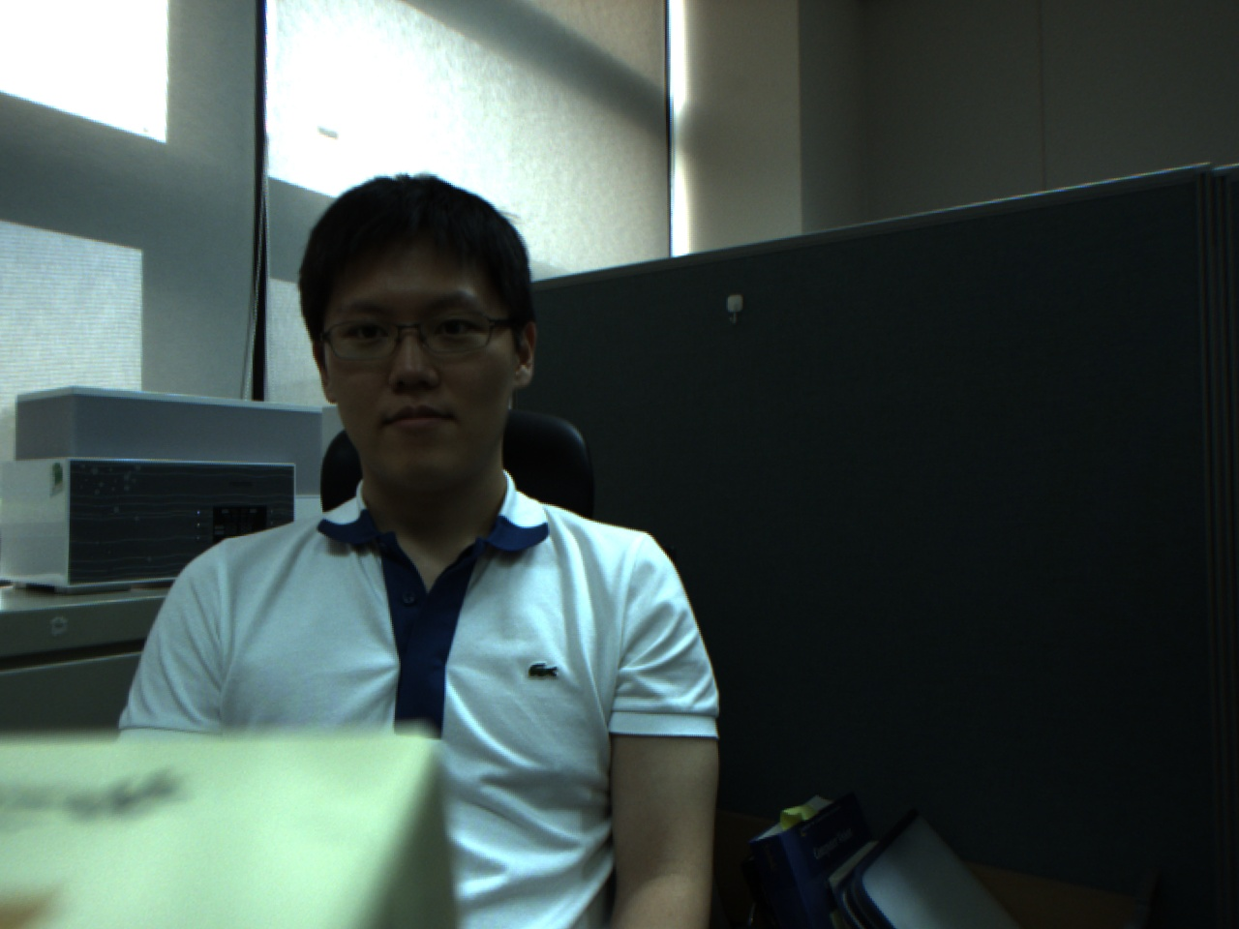
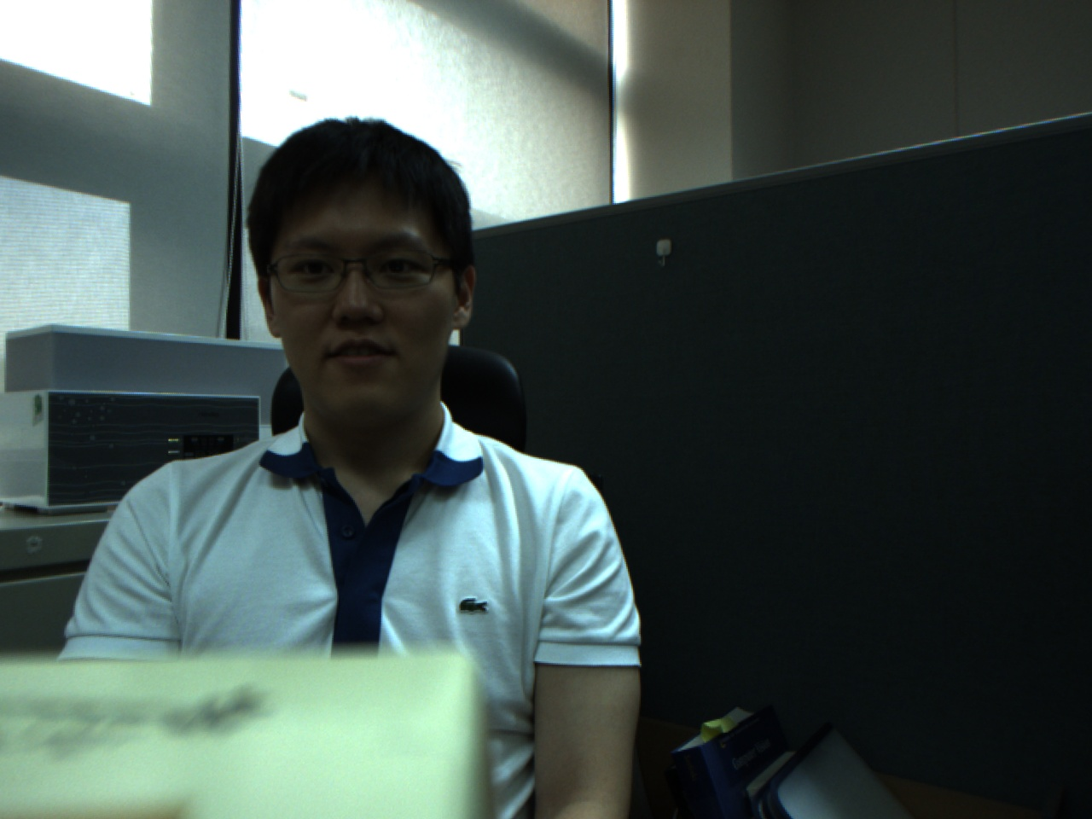
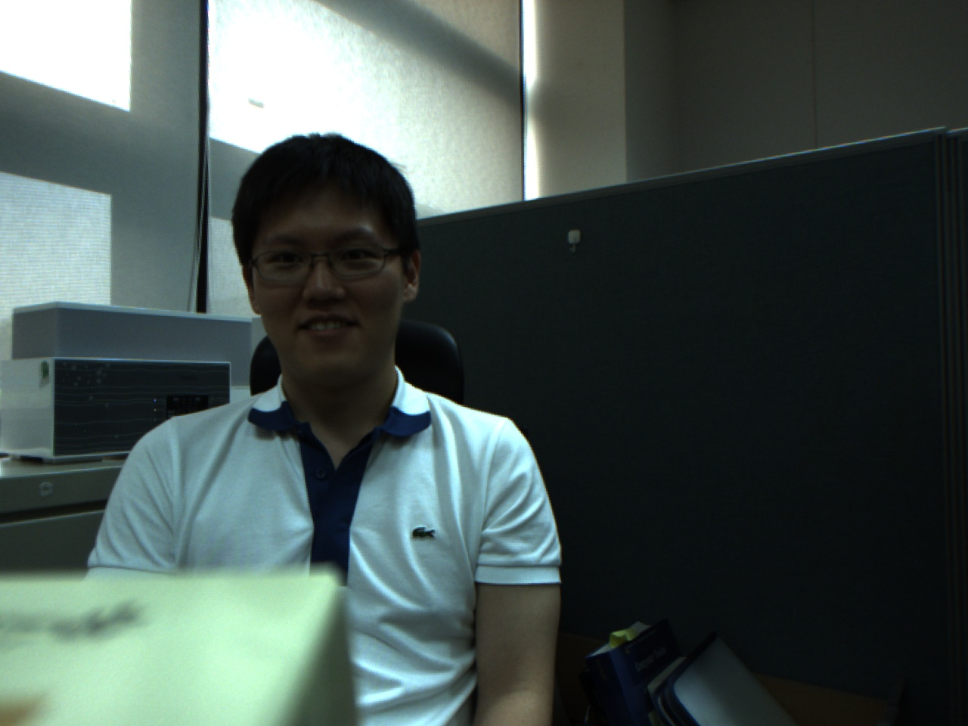
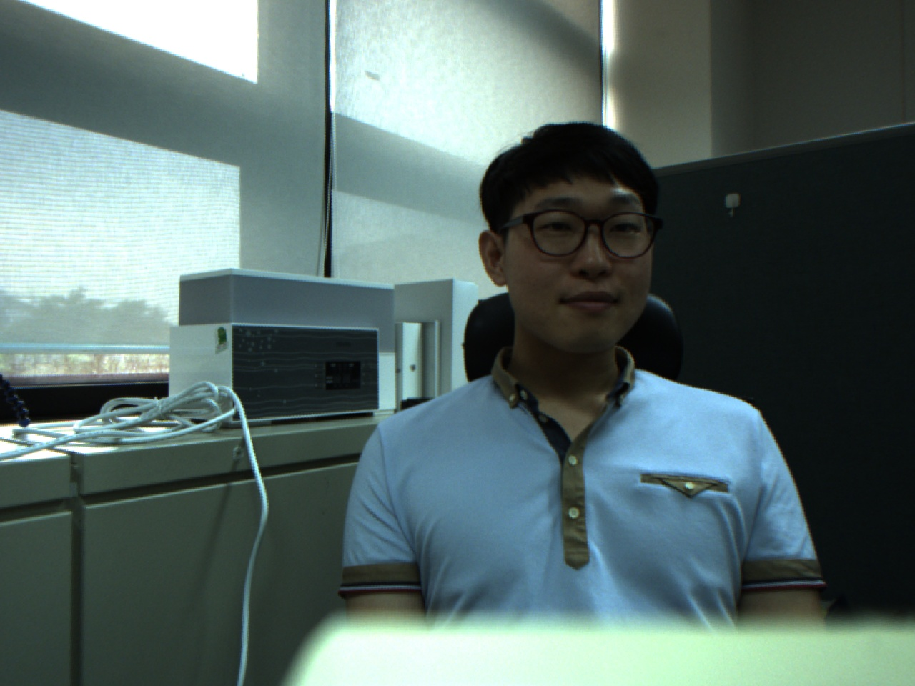
Test1 : 50%
Test2: 60%
Test1 : 90%
Test2: 100%

